Slide 1
Chapter Management Program
Demonstration for Pledges

Slide 2
Purpose of CMP
The Chapter Management Program is divided into three annual achievement levels for collegiate chapters:
  Accredited Chapter
  Chapter of Recognition
  Chapter of Excellence
All chapters are expected to reach the first level, Accredited Chapter. When all requirements for the first level are completed, the chapter may seek to achieve the second level, Chapter of Recognition, and then the third, Chapter of Excellence.
Notes:
The Chapter Management Program (CMP) is a three-tiered program with guidelines and operational requirements for all chapters. It helps collegiate chapter officers keep track of chapter management and formal communication with the Fraternity through its web-based program. The program is divided into three annual achievement levels for collegiate chapters: Accredited Chapter, Chapter of Recognition and Chapter of Excellence. Tier designations give chapters both incentive to manage their operations well, and also credit for activities completed throughout the year. Good record keeping through CMP simplifies operations for chapter officers, and keeps lines of communication open between chapters and the national organization, so potential problems can be addressed quickly by reviewing a chapter’s status online. The CMP Guide contains a wealth of information about CMP, including benchmarks for CMP tiers.

Slide 3
Accredited Chapter
Recruitment/Pledging
Membership
Finances
Professional and Service Programs
Leadership Development
Notes:
The Accredited Chapter represents basic operational requirements in the areas of:
Recruitment/Pledging
Membership
Finances
Professional and Service Programs
Leadership Development
These sections reflect the practice of essential business principles and operations expected of each chapter as part of our professional business Fraternity, as well as the professional and leadership development opportunities for each member.

Slide 4
Chapter of Recognition and Excellence
Alumni and faculty events
New member education
Large scale events
Promotion of the national Fraternity
Notes:
Additional optional requirements for Chapter of Recognition and Chapter of Excellence focus on alumni and faculty events, new member education, large scale events, and promotion of the national Fraternity. Chapters are recognized for the highest level they achieve so chapters are encouraged to set an annual goal of which tier to attain.

Slide 5
Chapter Responsibility
The Vice President-Chapter Operations (VPCO) has overall responsibility to ensure CMP submissions are made on time, but CMP is a chapter responsibility.
It is important for all members to know what items should be submitted and how to submit each.
Notes:
Even though the Vice President-Chapter Operations (VPCO) has overall responsibility to ensure CMP submissions are made, CMP is a chapter responsibility. Each year, the chapter should set a CMP goal and update the chapter on a regular basis. The VPCO should ensure items are submitted completely and promptly by the appropriate deadlines, but everyone in the chapter needs to be aware of the program and their individual roles in this process. It is important for all members to know what items should be submitted and how to submit each. The VPCO should fully understand the CMP submission process and work with all officers and members to ensure reporting is done in a timely and accurate manner.

Slide 6
Submitting CMP through the Hub
President
Senior Vice President
Vice President-Pledge Education
Vice President-Finance
Vice President-Chapter Operations
Chancellor
Vice President-Professional Activities
Vice President-Community Service
Vice President-Scholarship & Awards
Vice President-Alumni Relations
Chapter Fundraising Committee Chair
Webmaster
Notes:
Only the ten nationally recognized chapter officers (President, Senior Vice President, Vice President-Pledge Education, Vice President-Finance, Vice President-Chapter Operations, Chancellor, Vice President-Professional Activities, Vice President-Community Service, Vice President-Scholarship and Awards, and Vice President-Alumni Relations) along with Chapter Fundraising Committee Chair and Webmaster have access to submit forms and other requirements through the Hub, an officer only online module. Your chapter might have additional officers or committee members that are better suited to submit specific items, but forms are only available to be submitted by the President, VPCO and the appropriate officer. Additional officers and committee members will need to provide the information for the submission to the President or VPCO to be submitted.

Slide 7
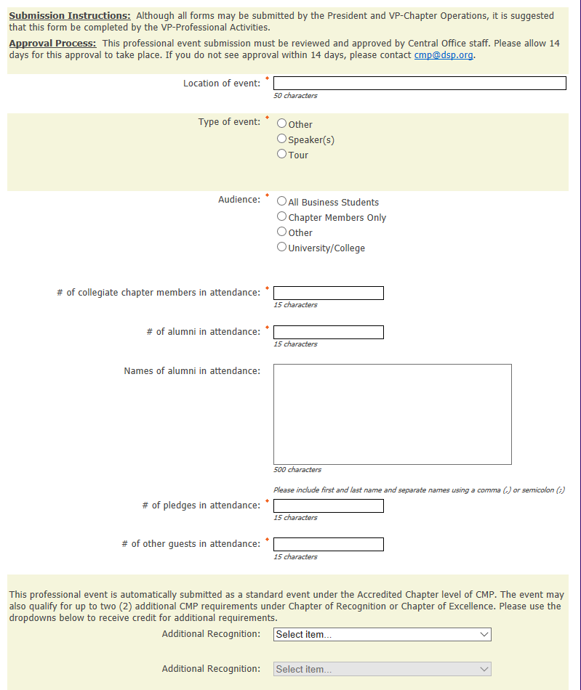
Sample Form
Professional Event Form
Notes:
On Event Forms, the chapter will submit key details about the event (like audience and attendance number) and provide a description.

Slide 8
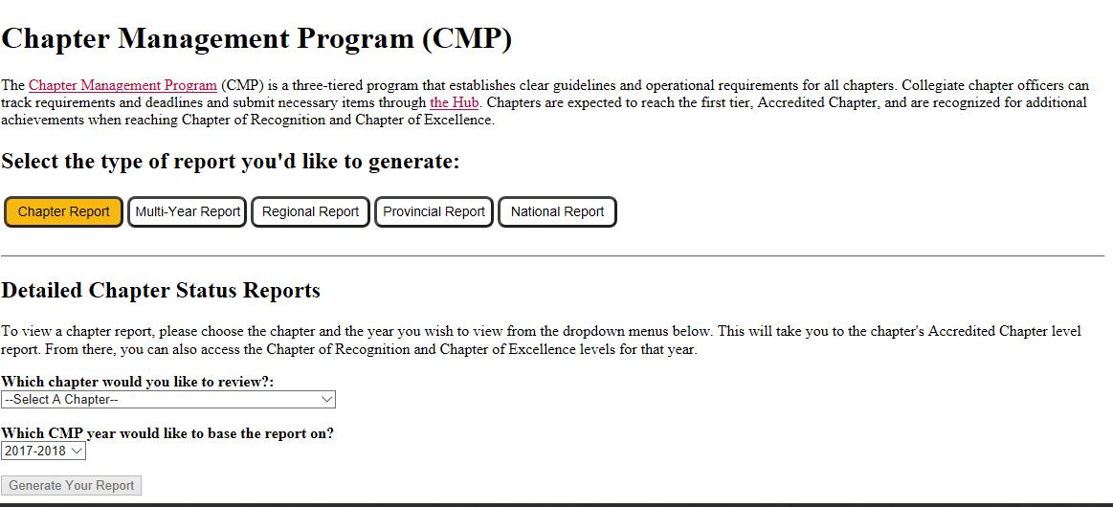
CMP Status Reports
Notes:
CMP Status Reports can be viewed by anyone (members, campus administrators, pledges, etc.) online at dsp.org/cmp. By viewing these reports, members can ensure the officers they elected are completing required items in a timely manner.

Slide 9
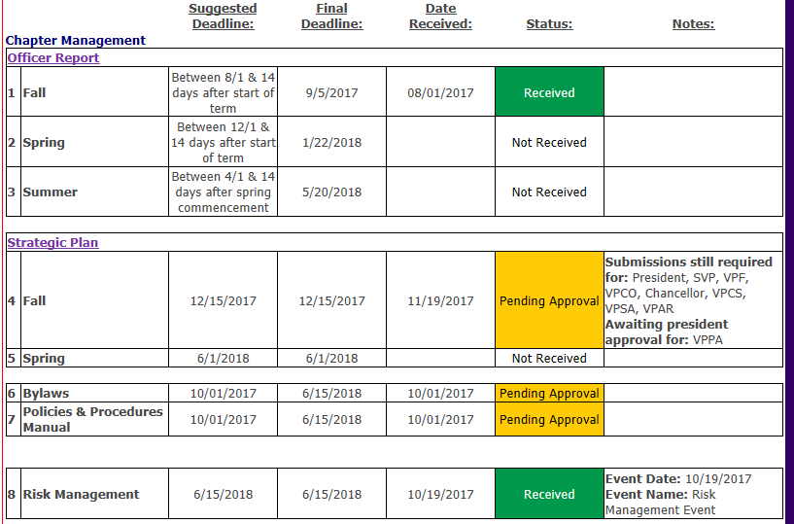
CMP Requirements
Notes:
As mentioned, the Accredited Chapter requires chapters to submit forms and reports to show the chapter is meeting the basic operational standards. The requirements of the pledge education program mirror many of the chapter’s requirements in CMP. For example, each pledge is required to pay initiation fees, of which most is passed onto the National Fraternity. Each pledge class is required to conduct a professional and service event, because these are also required by the chapter.
Throughout a semester, the chapter must report the following items and reports:
Officer Report- a report confirming officers
Strategic Plan- a report by each chapter officer showing goals and tentative plans for the next term/semester
Bylaws and Policies- governing documents of the chapter
Risk Management Event- a review of the risk management policy or a risk management topic completed for chapter members

Slide 10
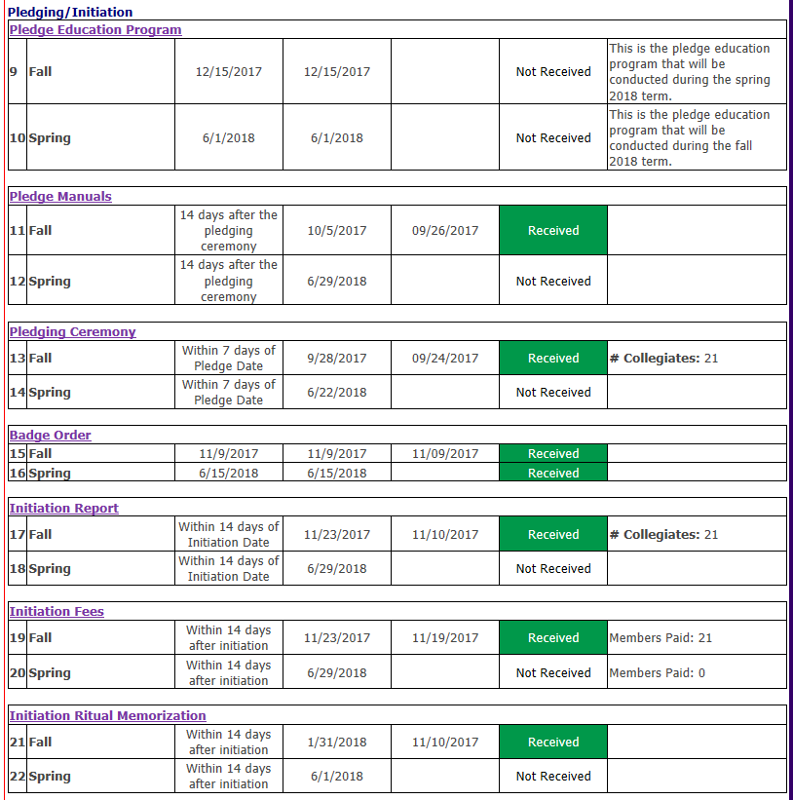
Notes:
Pledging and Initiation Process including, but not limited to:
Pledge Education Program
Pledge Manual and Badge Orders
A report of people pledging the chapter
A report of pledges initiated by the chapter
Payment of National Initiation Fees to the Fraternity

Slide 11
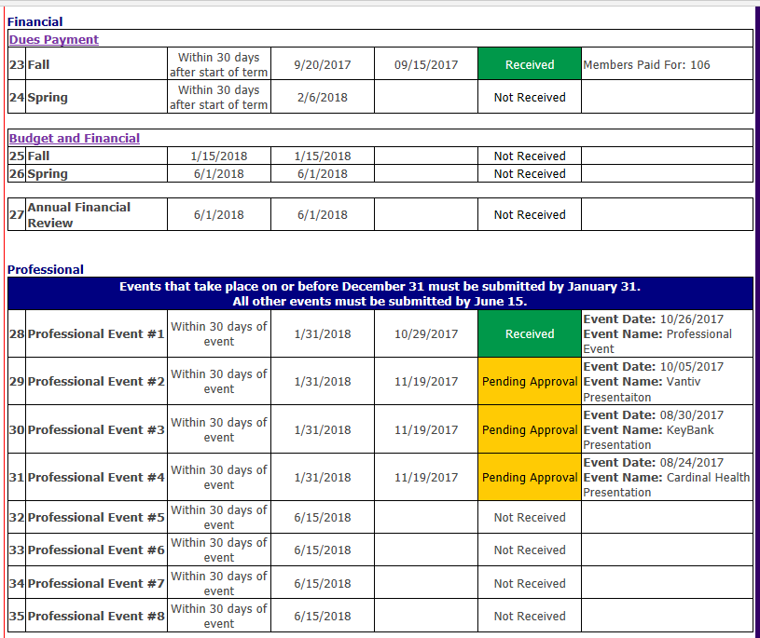
Notes:
Dues Payment- National dues paid by each member to the National Fraternity
Budget and Financial Statements
Annual Financial Review
Professional Events- each chapter is required to conduct eight (8) professional events annually

Slide 12
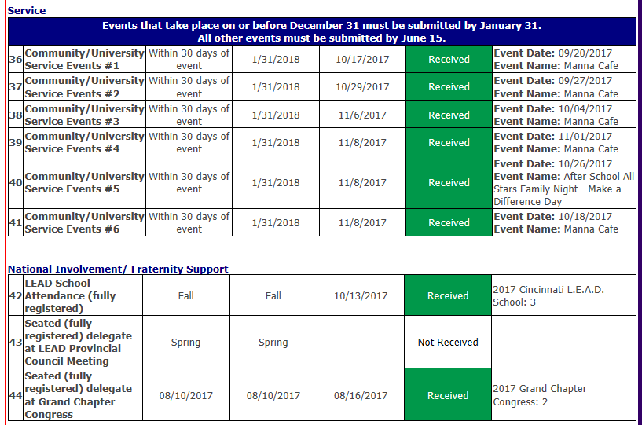
Notes:
Service Events- each chapter is required to conduct six (6) service events annually
Attendance to LEAD events and Grand Chapter Congress

Slide 13
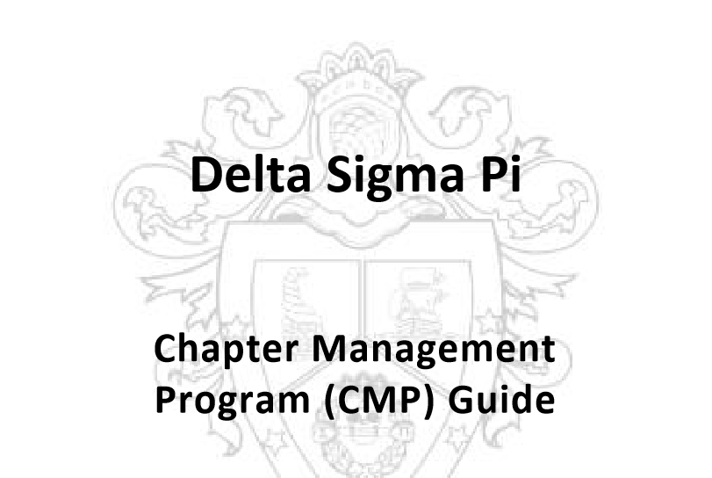
Resource: CMP Guide
www.deltasigmapi.org/docs/default-source/resources/cmp.pdf
Notes:
Instructions: Open the CMP Guide online (https://www.deltasigmapi.org/docs/default-source/resources/cmp.pdf) and show how each item is detailed in the manual.
The CMP Guide contains all policies and information about CMP, including details and submission information for each requirements.

Slide 14
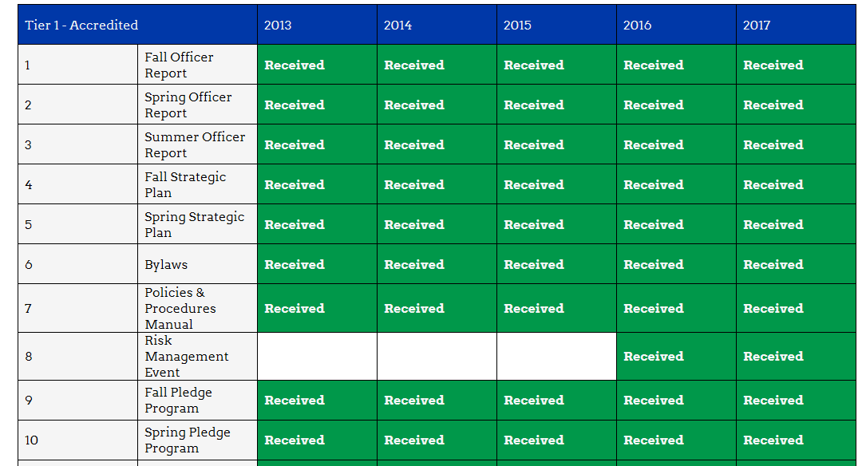
Resource: Website
Multiyear Report
www.dsp.org/cmp
Notes:
Instructions: Go to www.dsp.org/cmp and run the multiyear report to show how the chapter has done over the last couple of years. Run a regional report to show how your chapter compares to others in the region.
By looking at the CMP reports available online, the chapter can strive to do better than before and/or better than others chapters.

Slide 15
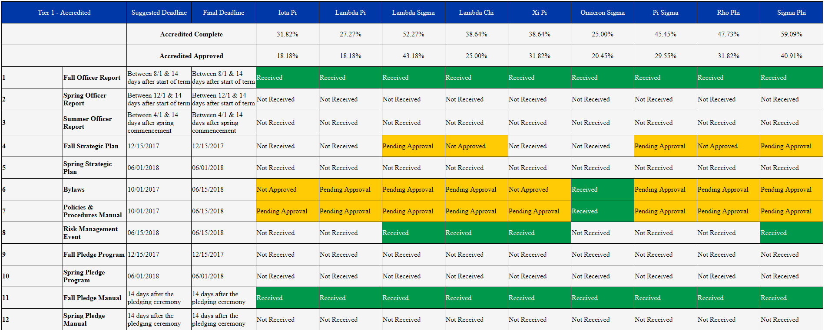
Resource: Website
Regional Report
www.dsp.org/cmp
Notes:
Instructions: Go to www.dsp.org/cmp and run the multiyear report to show how the chapter has done over the last couple of years. Run a regional report to show how your chapter compares to others in the region.
By looking at the CMP reports available online, the chapter can strive to do better than before and/or better than others chapters.

Slide 16
Thank You!
We hope you found this presentation helpful.

