Slide 1
Delta Sigma Pi is for Life
How to Stay Involved After Graduation

Slide 2
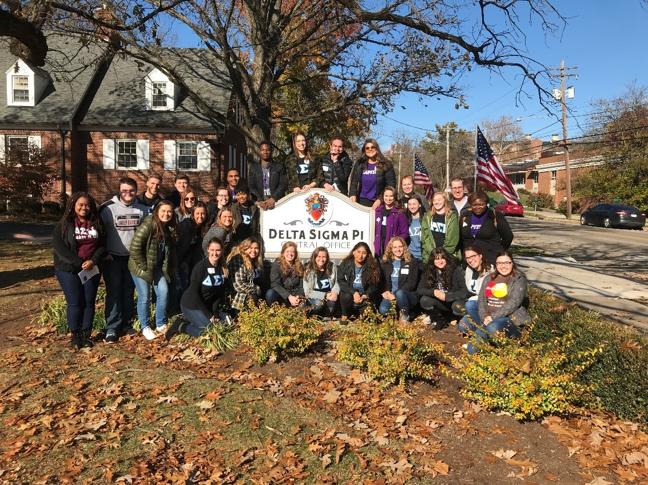
Why Stay Involved?
Brotherhood for life!
Continuous professional development
Give back to other brothers

Slide 3
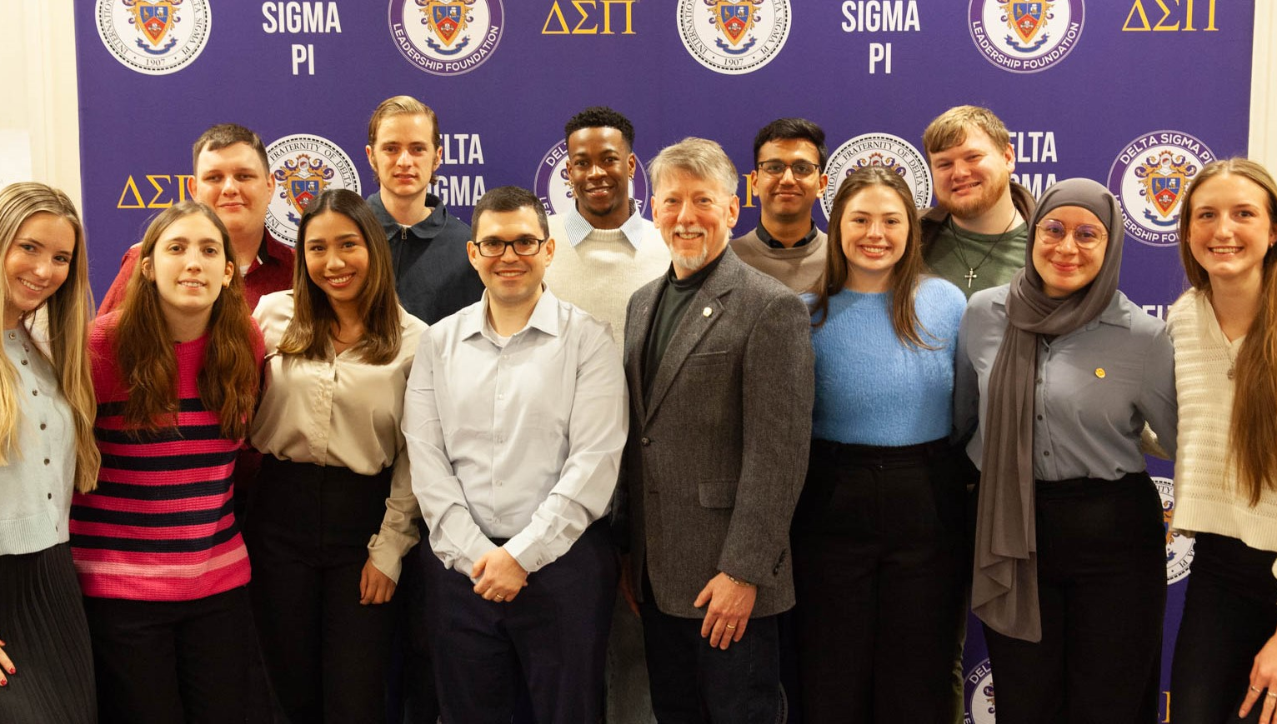
Fraternity Benefits
Career Development
Fraternity Partners
Deltasig E-Learning

Slide 4
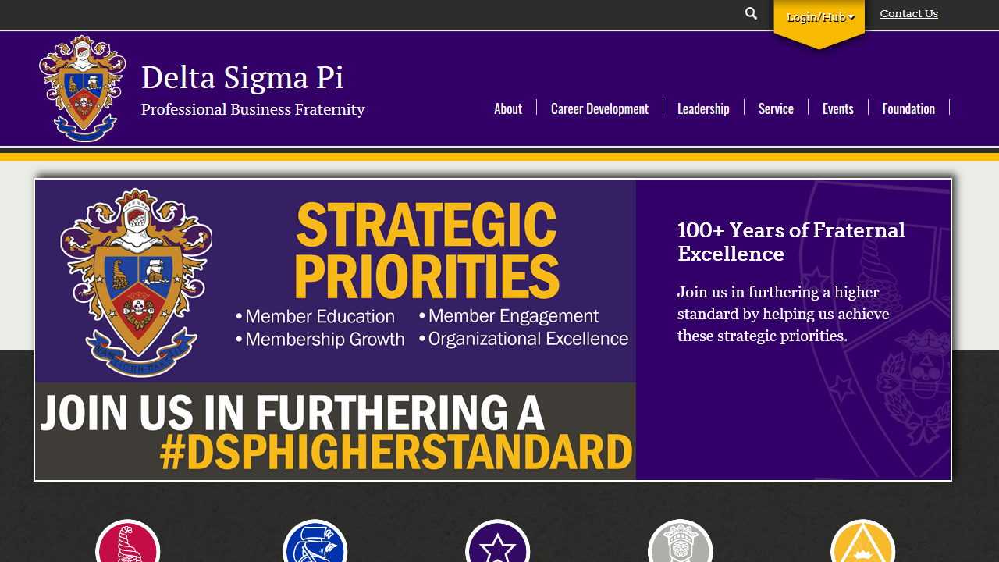
Update Your Contact Information
Notes:
Encourage students to change email from their campus email to a personal email

Slide 5
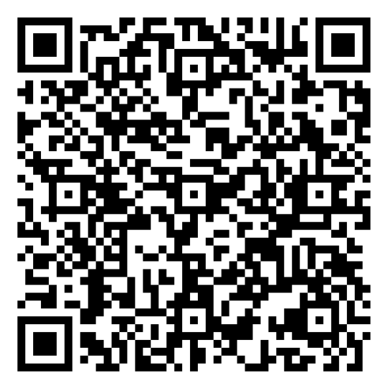
Pause!
Before we move on, take a moment to
update your contact info.
Specifically, make sure your information
is up to date and that you have an email
address listed that is NOT your campus
email.

Slide 6
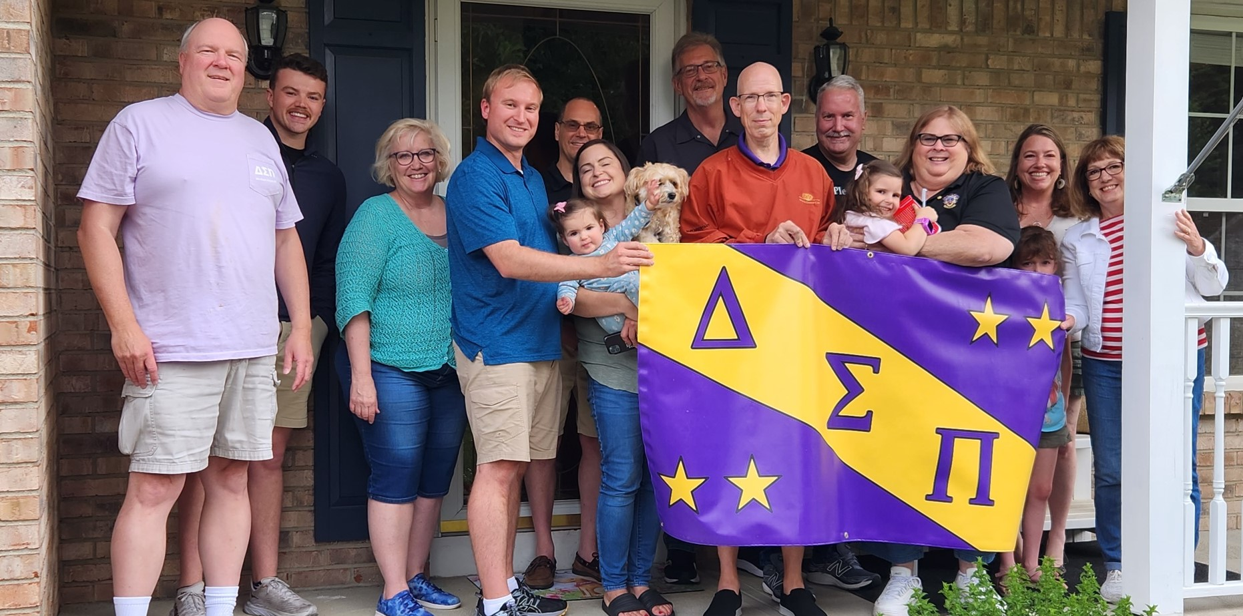
Alumni Chapters
Join an Alumni Chapter
Start a new Chapter– see if an Alumni Contact is interested in starting one in your area
Notes:
Alumni chapters are a great way to stay involved after graduation!

Slide 7
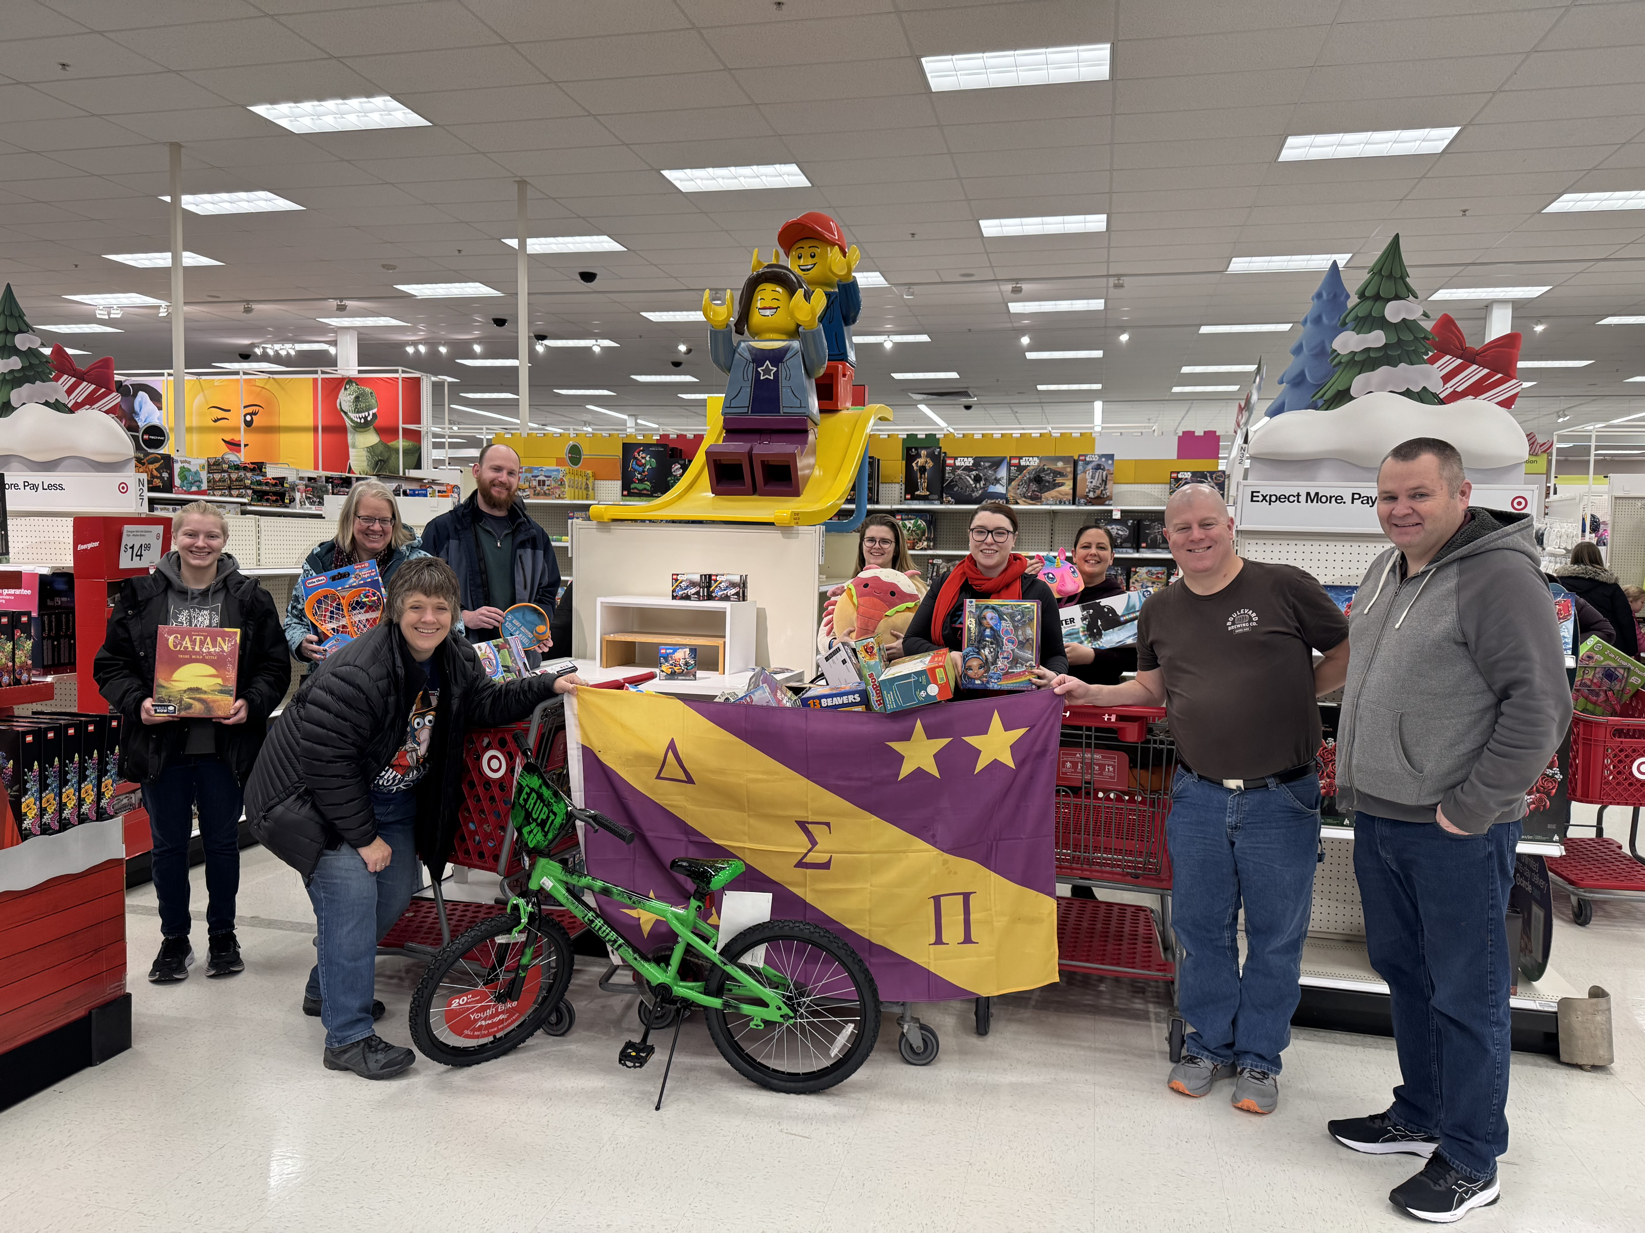
What Do They Do?
Provide a local network for alumni
Act as a resource for collegiate chapters
Host a variety of social, professional, and service events

Slide 8
How Are They Different?
No CMP requirements!
No regular chapter meetings
  In many chapters, events are more social with one business meeting per year to elect officers
No attendance policies for members
Low chapter dues
  Chapter dues generally range from $10-$50 per year, depending on the chapter
Notes:
ACs are often much less formal and more social. There are few requirements and you can come to events as often as you want.

Slide 9
Find a Local Alumni Chapter
Visit www.dsp.org/alumni-members
Ask your Regional VP, Provincial VP or Provincial Alumni Development Chair
Contact Central Office
  alumni@dsp.org
  513-523-1907
Seek out alumni at national events

Slide 10
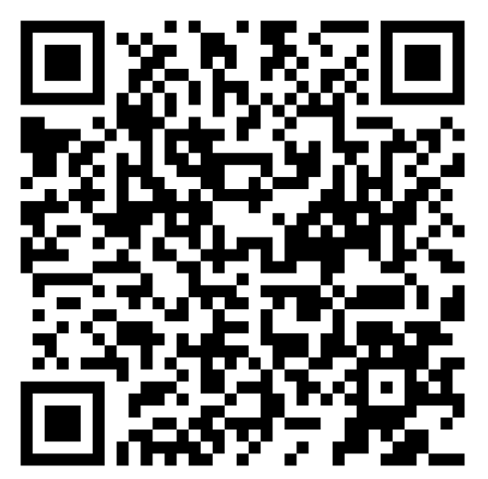
Pause!
Where are you moving after graduation? Take
a moment to see if there is an alumni chapter
in your area
If there is, write down the name of the
chapter, the chapter contact, and see if
you can find their social media.
If there is not, find out who your RVP will
be so you can ask them about alumni
opportunities in the area.
Notes:
This QR code directs to the chapter locator feature on the website

Slide 11

Network through
Social Media
Facebook
  Official DSP page
  One of many unofficial groups
Instagram
LinkedIn
X
YouTube
Notes:
Besides alumni chapters, there are many other ways to get involved, both big and small

Slide 12
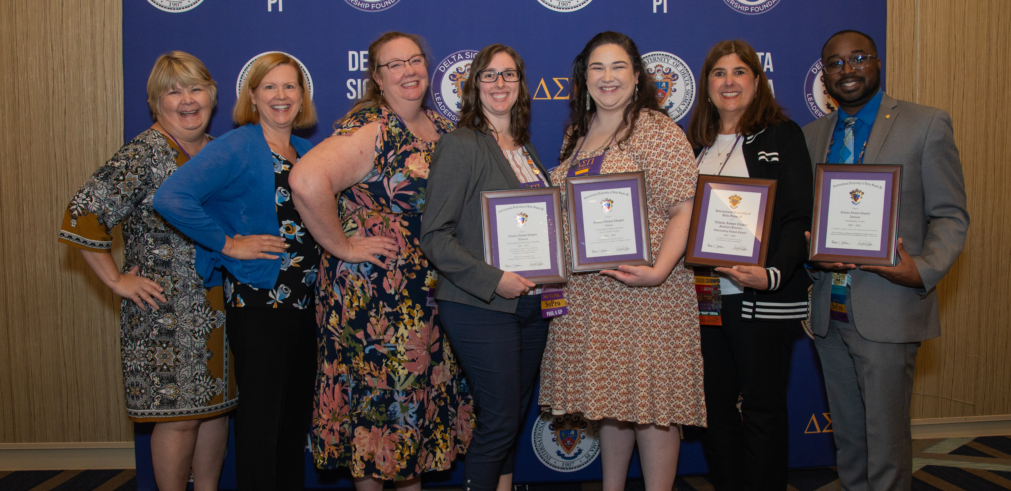
Attend National Events
Alumni can attend various national events for professional development, networking opportunities, and opportunities to serve collegiate brothers
  LEAD Schools (Fall)
  LEAD Summits (Fall)
  LEAD Provincial Conferences (Spring)
  Grand Chapter Congress (Odd year
  summers)
  Volunteer Leadership Trainings

Slide 13
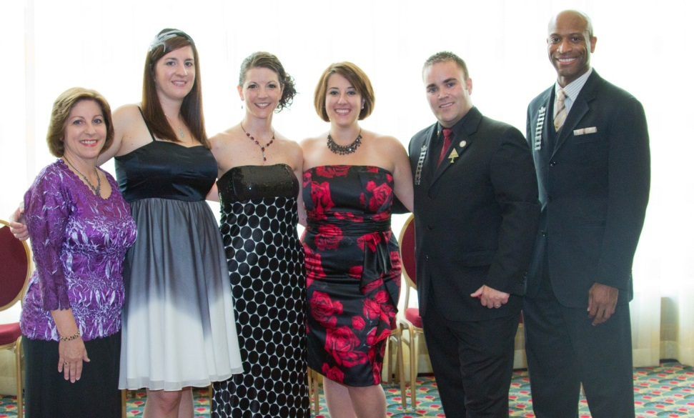
Offer Financial Support
Donate to a Leadership Foundation fund or the Deltasig Fund
Help to start a scholarship for a chapter
Donate directly to a chapter (Learn more about Chapter Leadership Funds)
Participate in our Founders’ Day Challenge
and 4/25 annual giving drives
Become a Chapter Champion
Notes:
Donating to the Leadership Foundation will continue your subscription to The DELTASIG magazine, which is filled with current information about the Fraternity and is a great way to stay informed. You could also make a financial contribution to start a scholarship for a chapter or even donate directly to a chapter towards operating costs or special events.

Slide 14
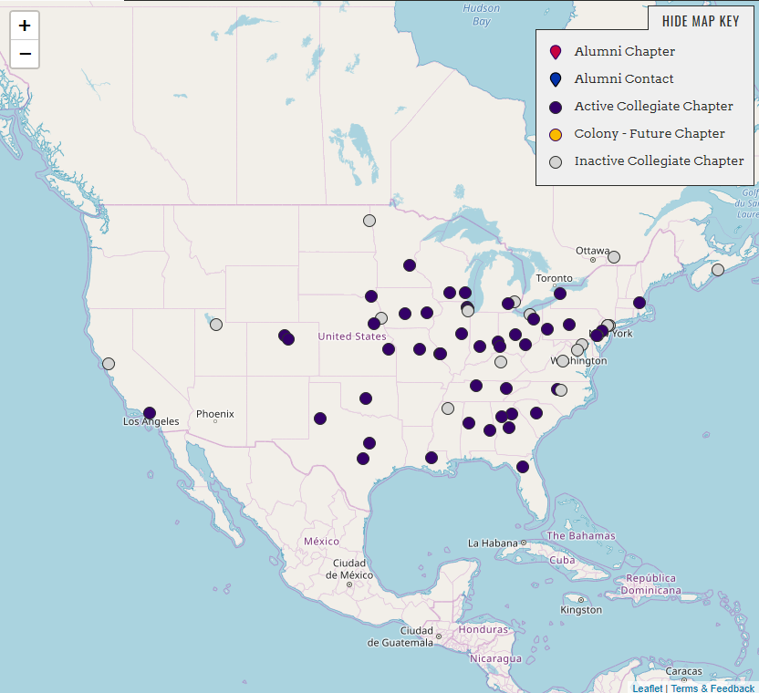
Think Globally, Act Locally
Assist local collegiate chapters
Find out how to start a new one

Slide 15
Volunteer
District Director, Assistant DD
Chapter Advisor
Regional Vice President
Provincial Vice President
Board of Directors (Grand President and VP-Finance)
Leadership Foundation Trustee
Contributor to The Deltasig magazine or Delta Sigma Pi news
Regional, Provincial, and National Committee Member
  Alumni Development
  Community Service
  Professional Development
  Scholastic Development and Awards
Leadership Foundation Committee Member
Chapter Champion
And more!
Notes:
Presenter should touch on time commitments, such as saying how some roles have a fairly small time commitment (an hour a month) whereas others have a much larger time commitment. Opportunities are available for everyone!

Slide 16
Interested in Volunteering?
Contact your Provincial or Regional Vice President
Contact Central Office staff
Find more information in Volunteer Leadership Manual
Complete the Volunteer Interest Form

Slide 17

Certified Deltasig Leader (CDL)
Tier 1
  Core Volunteer Leadership Training E-learning Modules
Tier 2
  Fraternity event participation
  Complete the Advanced Volunteer Leadership Training E-learning Modules
  Learn more at dsp.org/beacdl

Slide 18
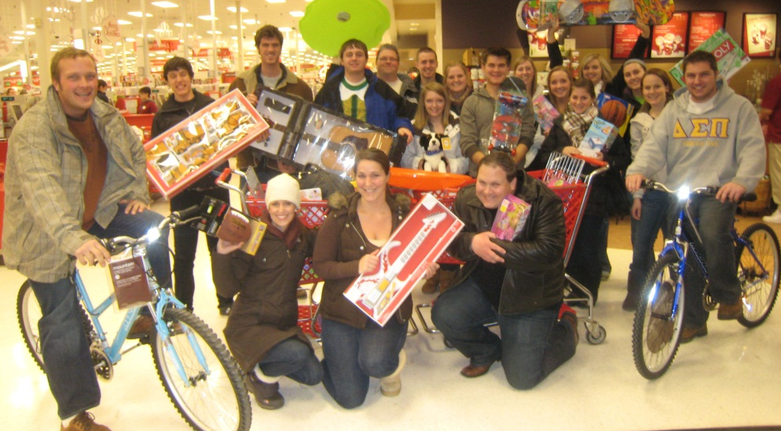
Start Building Your Fraternal Network Today
Update your contact information
Learn more about alumni life
Contact your local alumni chapter

Slide 19
There is no set path for alumni!
Alumni life looks different for every brother and at every stage of life!
Consider what alumni life can look like for you after graduation and know that this can change
The alumni experience is not linear!

Slide 20
Pause!
What might alumni life look like for you next year? What are you hoping to gain from DSP after graduation?
Take a moment to write down your answers to those questions.
Write down one action item you will take over the summer to help connect you with the fraternity.
  Ideas include connecting with alumni on social media, contacting an alumni chapter, or contacting your RVP
Share your ideas with a partner.

Slide 21
Thank You!
To receive a copy of this PowerPoint Presentation, please contact centraloffice@dsp.org.
To receive credit for this presentation towards Certified Deltasig Leader (CDL) renewal certification, please visit this page.

